Slide 1
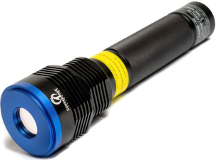
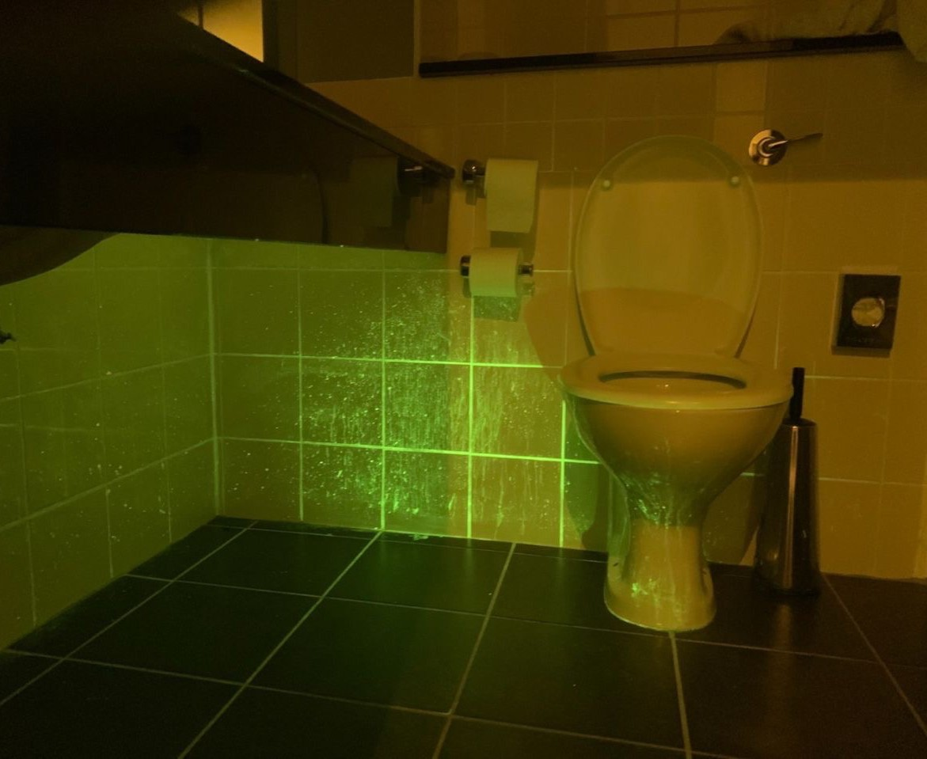
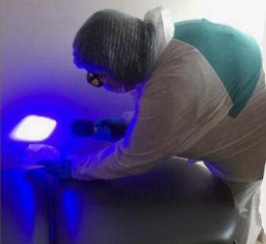
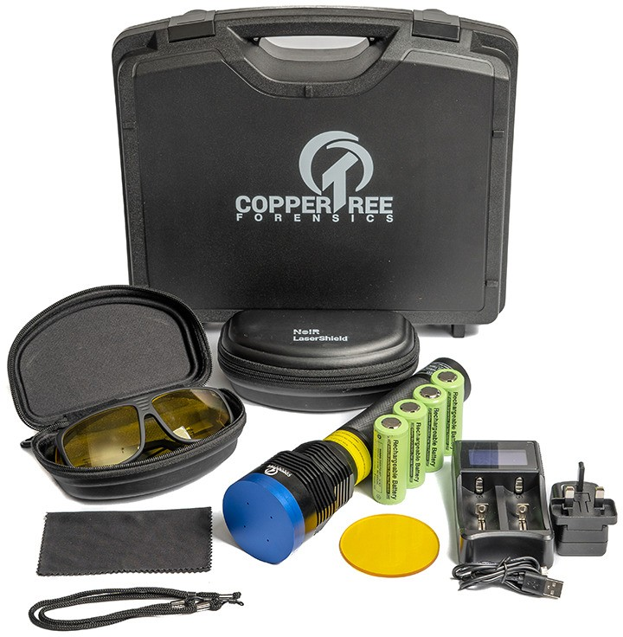
Concept BioTorch™ powered by CTF Technologies
Partner in Building Your Brand™
Inspect, Detect & Correct surface soil with our proprietary BioTorch™ system.
#seetheunseen
BENEFITS
Instantly see problem soil areas
Educate, train staff
Improve cleaning protocols
Prepare for audits
No markers, lab tests, waiting
Seeing Is Believing
INSERT
AFTER
CLEANING
IMAGE
INSPECT – Illuminate areas using BioTorch™ + proprietary glasses
DETECT – Instantly see if organic soils and pathogens are visible
CORRECT – Verify clean, refine protocols
Kit Contents
Concept BioTorch™ with Protective Cap
4 Rechargeable Batteries + Battery Charger
1X Pair BioTorch™ Filtered Glasses with Protective Case
Lens Cloth Cleaner
Durable Hinged Carry Case with Handle
CONCEPT MANUFACTURING
www.conceptmanufacturing.com
John.feeny@conceptmanufacturing.com
13417 Benson Avenue
Chino, CA 91710
Phone: 248-421-1567
Revision Date: 03/09/2023

